Slide 1
Domain Name Server (DNS) Filtering Service using Threat Intelligence feeds and AI/ML Techniques
CSE7101- Capstone Project
Review-2
Batch Number: CSE 75
Under the Supervision of,
Dr. Ayesha Taranum
Professor
School of Computer Science and Engineering
Presidency University
Roll Number 20221CSE0309 20221CSE0346 20221CSE0367 | Student Name Saish Savadatti Suhas C Lingana Gouda
Name of the Program: B.Tech
Name of the HoD: Dr Asif Mohamed H B
Name of the Program Project Coordinator: Dr.Jayavadivel Ravi
Name of the School Project Coordinators: Dr. Sampath A K , Dr. Geetha A

Slide 2
Content
Abstract
Objectives
Existing Methods and Drawbacks
Proposed Method & Feasibility Study
Architecture Diagram
Modules
Hardware and Software Details
Timeline (Gantt Chart)
References

Slide 3
Abstract
The Domain Name System is important for the working of the internet. Attackers target DNS for harmful actions. Traditional DNS filtering methods rely on blocklists and can’t detect unknown or new domains. In this paper we examine a DNS filtering solution that uses machine learning and live threat intelligence feeds to continuously classify domain types and provide the domain reputation in real time. By utilizing these techniques, it is possible to identify suspicious domains sooner and with better accuracy. This strengthens network security and we can deal with evolving threats

Slide 4
Objectives
Core DNS Resolver – Python-based proxy, forwards legit queries to upstream (e.g., 8.8.8.8)
Threat Intelligence – Integrate 2+ open-source feeds (STIX format)
AI/ML Classifier – Random Forest/Logistic Regression, >90% accuracy for DGA detection
DNS Tunneling Detection – Heuristic checks (entropy, length, TXT/NULL records)
High Performance – In-memory LRU cache, <100ms lookup time
Web Dashboard – FastAPI + Bootstrap, real-time stats & domain lookup

Slide 5
Existing Methods and Drawbacks
Static Blacklisting → Fast, simple, low overhead; but reactive, fails on zero-day threats
Commercial Secure DNS → Reliable, scalable, strong intel; but costly, privacy issues, limited customization
Signature-Based IDS/IPS → Blocks known patterns; but needs updates, evadable with DoH/DoT
ML-Based Solutions → Proactive, good for DGAs/zero-day; but higher latency, false positives, resource-heavy
Gap → No single method is sufficient → need hybrid approach

Slide 6
Proposed Method & Feasibility Study
Query Processing Pipeline
Cache Lookup → Immediate response if cached (low latency)
Whitelist Check → Trusted domains bypass checks
Threat Intel Blacklist → Block if domain matches feeds
AI/ML Classification → Detect DGAs using lexical features
DNS Tunneling Detection → Heuristic checks (length, entropy, TXT records)
Upstream Resolution → Forward safe queries, cache response
Feasibility Study
Technological → Python + dnslib, FastAPI, scikit-learn, open-source TI feeds
Economic → 100% open-source, no costly infra, runs on laptop/VPS
Resource → Suitable for single developer; lightweight ML, simple cache, focused scope
Outcome → Balanced, reactive + proactive DNS security solution with high performance

Slide 7
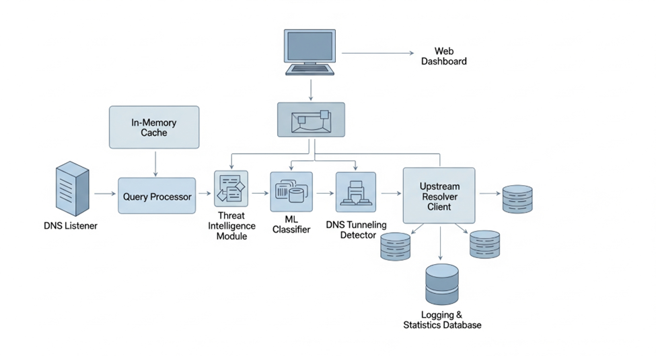
Architecture Diagram

Slide 8
Modules
The project is divided into the following distinct software modules:
DNS Server (dns_server.py): Implements the main UDP socket server. Listens for incoming DNS queries, deserializes them, passes them to the Query Handler, and sends back the final response.
Query Handler (query_handler.py): Contains the core logic for the filtering pipeline. It invokes the cache, TI, ML, and tunnelling modules in sequence.
Cache Manager (cache_manager.py): Implements an LRU cache with TTL support. Provides get() and set() methods.
Threat Intelligence Client (threat_intel_client.py): Fetches blocklists from external APIs on a schedule and loads them into a Python set for O(1) average time complexity lookups.
ML Classifier (ml_classifier.py): Loads the pre-trained DGA detection model and contains functions for feature extraction and prediction.
Dashboard Application (dashboard_app.py): A FastAPI/Flask application that serves the web dashboard and provides API endpoints for stats and manual lookups.
Logging Module (logger.py): A centralized utility that writes structured logs to a file, capturing details of every blocked query.

Slide 9
Hardware and Software Details
Hardware Requirements:
  Processor: Intel Core i5 / AMD Ryzen 5 or equivalent.
  RAM: 8 GB minimum.
  Storage: 50 GB SSD.
Software Requirements:
  OS: Windows 10/11, macOS, or Linux.
  Language: Python 3.9+
  Libraries: FastAPI, Uvicorn, dnslib, scikit-learn, pandas, numpy, cachetools, requests.
  Frontend: HTML5, CSS3, Bootstrap 5, JavaScript.
  Development Environment: VS Code.
  Version Control: Git.

Slide 10
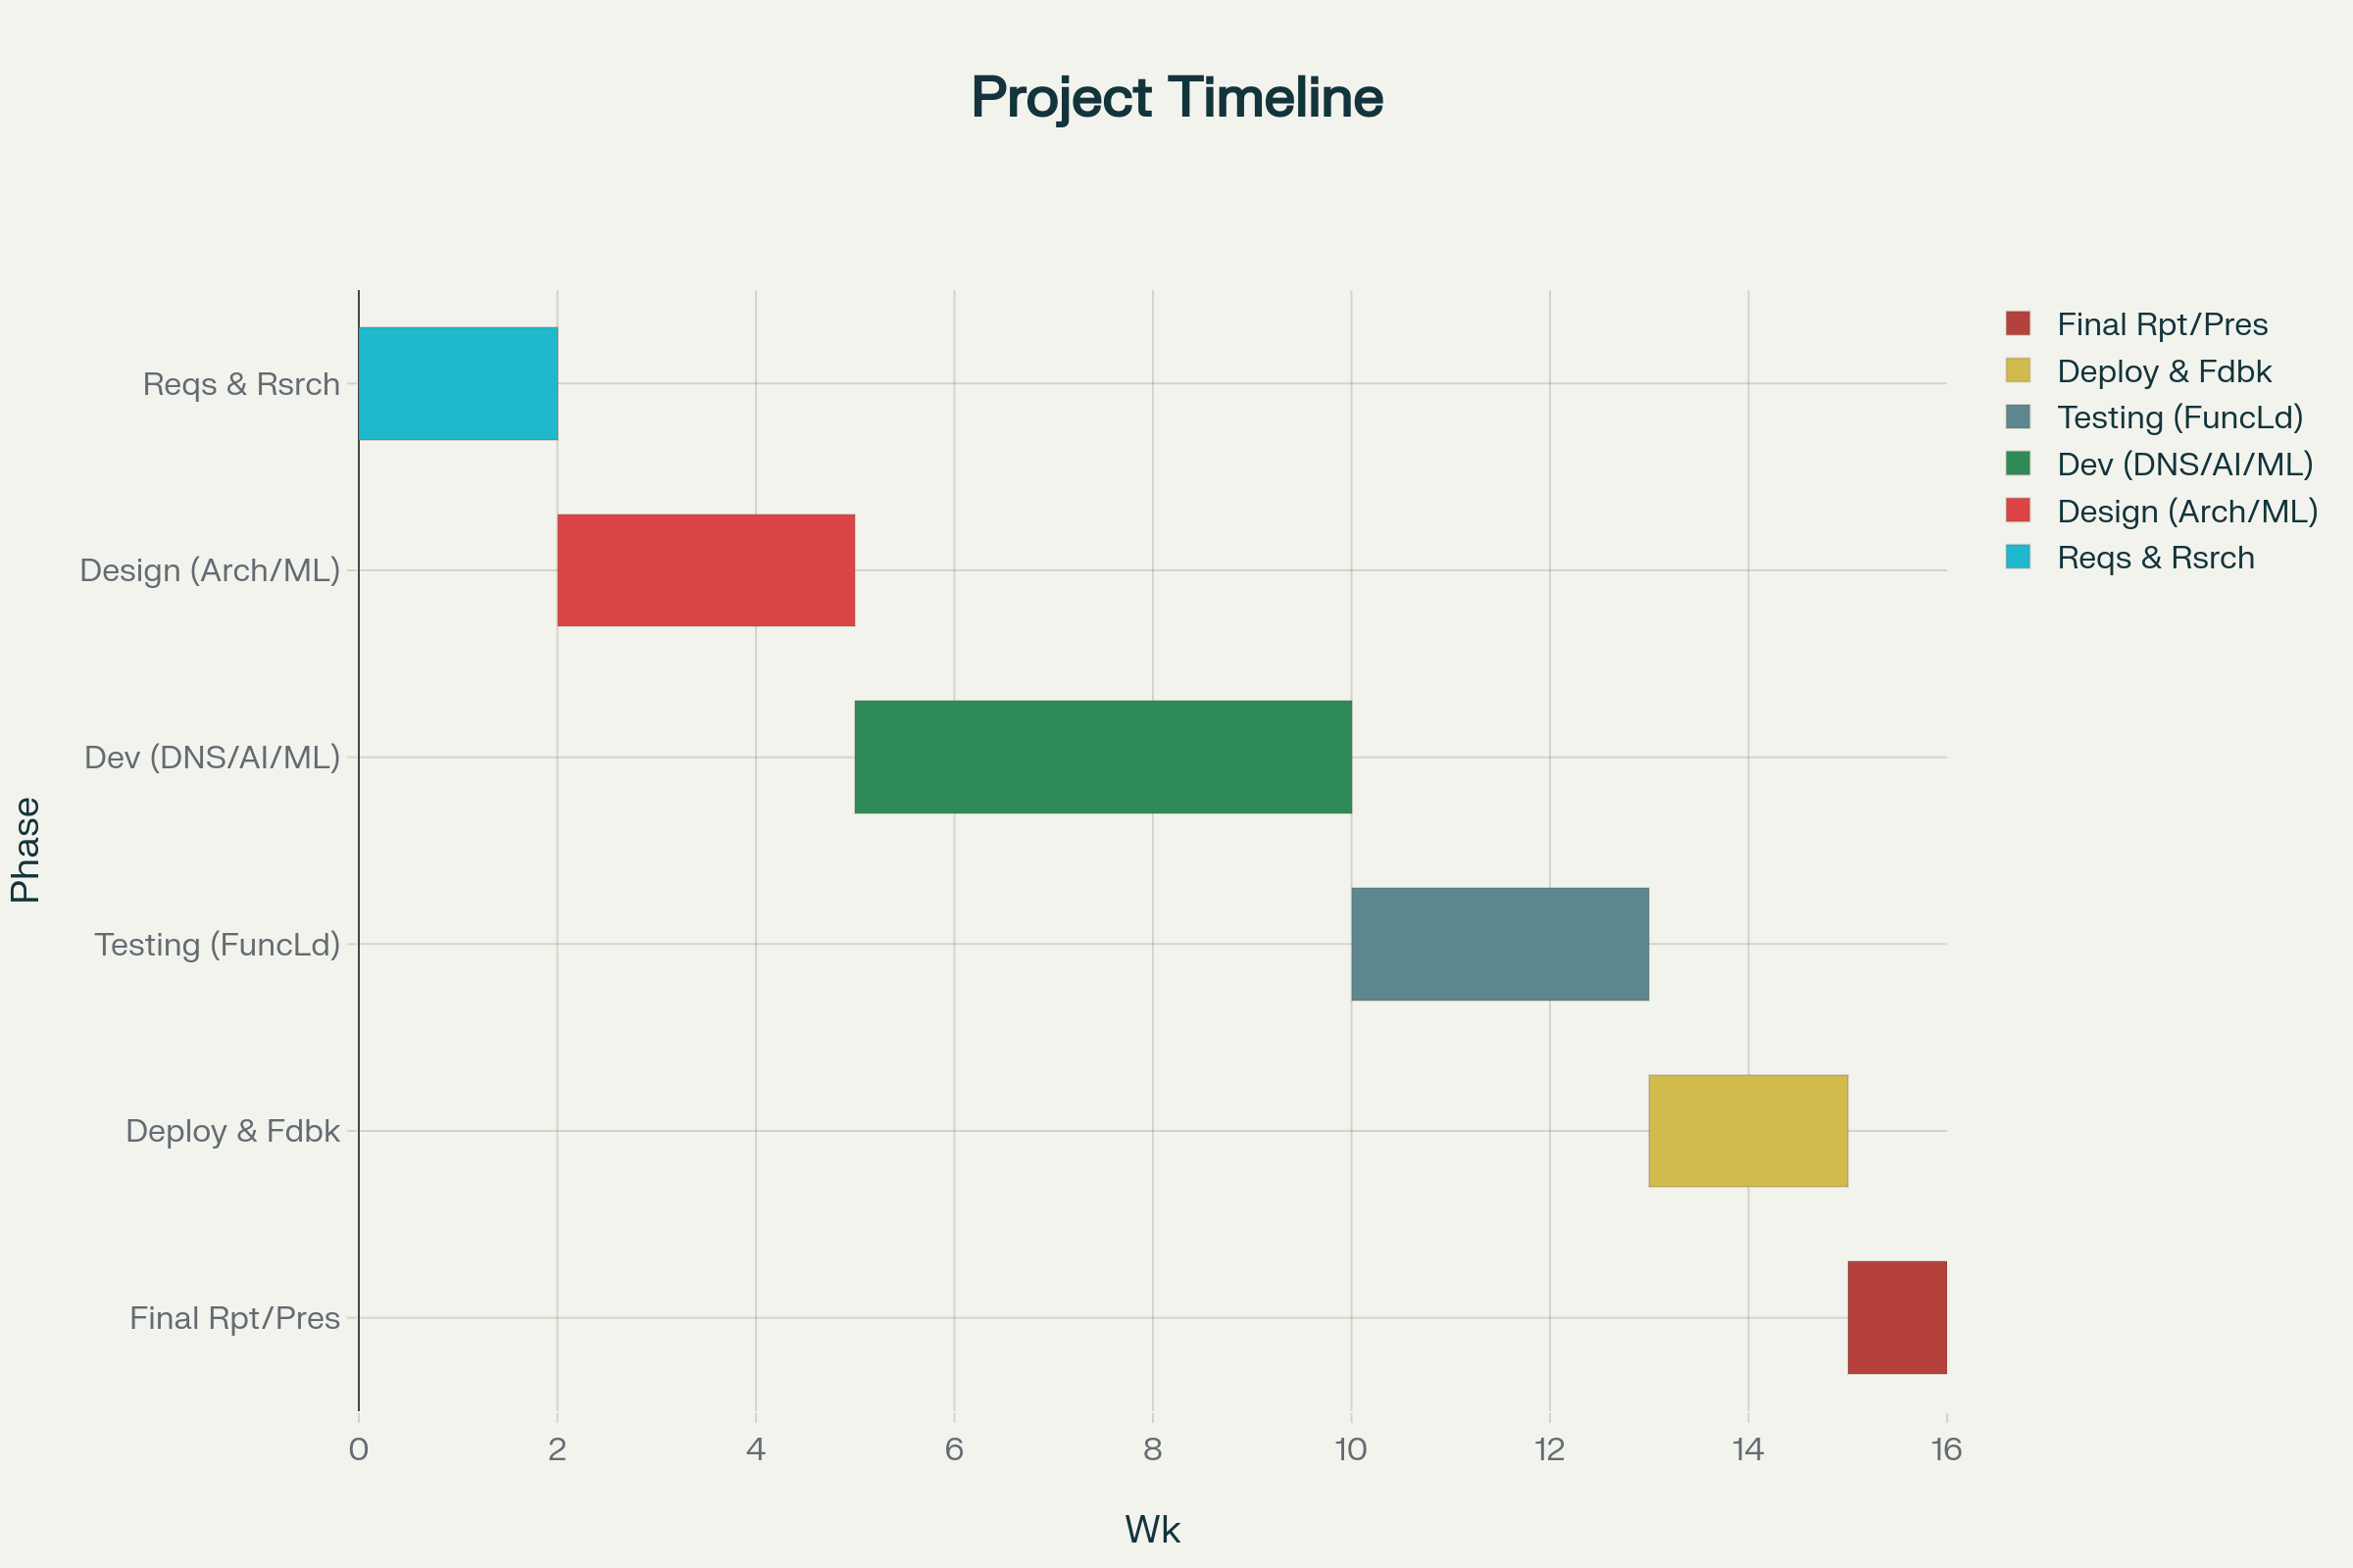
Timeline of the Project (Gantt Chart)

Slide 11
References (IEEE Paper format)
[1] Y.-D. Yan, J.-F. Xue, J.-W. Zhong, Z.-Y. Liu, Y. Wang, and D. Cheng, “Malicious Domain Detection Based on Machine Learning,” dtcse, no. iceit, Mar. 2018, doi: 10.12783/dtcse/iceit2017/19866.
[2] Y. Cheng, N. Li, Y. Liu, C. Li, Y. Du, and Z. Zhang, “In-Depth Evaluation of the Impact of National-Level DNS Filtering on DNS Resolvers over Space and Time,” Electronics, vol. 11, no. 8, p. 1276, Apr. 2022, doi: 10.3390/electronics11081276.
[3] D. Chepel and S. Malakhov, “Summary of DNS traffic filtering trends as a component of modern information systems security,” CS&amp;CS E-journal, no. 1, pp. 6–21, Sept. 2024, doi: 10.26565/2519-2310-2024-1-01.
[4] A. Hounsel, K. Borgolte, P. Schmitt, J. Holland, and N. Feamster, “Comparing the Effects of DNS, DoT, and DoH on Web Performance,” July 18, 2019. doi: 10.48550/arxiv.1907.08089.
[5] R. Mitsuhashi, Y. Takai, T. Shinagawa, K. Iida, and Y. Jin, “Malicious DNS Tunnel Tool Recognition Using Persistent DoH Traffic Analysis,” IEEE Trans. Netw. Serv. Manage., vol. 20, no. 2, pp. 2086–2095, June 2023, doi: 10.1109/tnsm.2022.3215681.

Slide 12


